Slide 1
DNA Damage
By
Prof. Mangat Ram Sharma
Department of Zoology
Govt. Post Gradauate College Rajouri

Slide 2
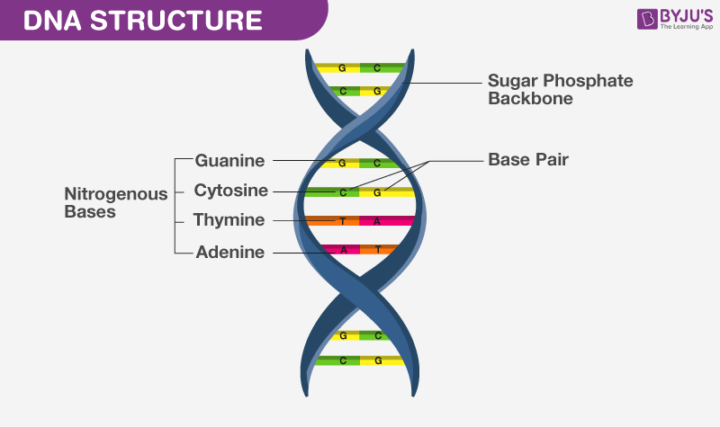

Slide 3
DNA?
Self replicating material, carrier of genetic information in nearly all living organisms
Consists of two polynucleotide chains which are coiled around each other to form double helical structure
Controls hereditary information by synthesizing proteins
DNA mRNA RNA ribosome complex decoding of codons proteins

Slide 4
The proteins are the structural and functional units which control the phenotype of an individual
Change in Codon that leads to change in proteins that leads to change in phenotype
DNA Damage
Change in Codon or in the chemical structure of DNA due to breaks missing of bases or addition of changed bases

Slide 5
Mutations Vs DNA damage
Mutations are simply change in the base sequence of the DNA, they don’t include breaks, missing of bases or addition or deletion of the bases

Slide 6
Damage
Natural Environmental
Natural Damage
Due to metabolic and hydrolytic processes
Hydrolytic processes:
Occurs in water due to metabolites and excess of reactive oxygen species
Metabolites
Cytosine changes to Uracil in p.o. Sodium bisulfite due to deamination of the cytocine

Slide 7
Reactive oxygen species
Peroxides, superoxides, hydroxydes radicals provide excess of oxygen leading to DNA damage
Environmental factors
UV radiations, ionizing radiations and genotoxic chemicals

Slide 8
UV radiations
UV radiations cause breaks in the DNA strands which are repaired upto large extent but remain despite all efforts i.e. incomplete repair
Ionizing Radiations
They cause change in the functional groups of nitrogenous bases such as NH2, CH3 by ionizing them

Slide 9
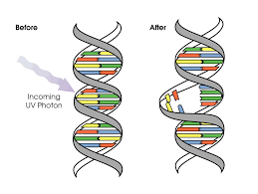

Slide 10
Genotoxic Substances
Genotoxic chemical indicates a chemical capable of causing damage to the DNA of a target cell
An examle of genotoxic is Pyrrolizidine alkaloids (PAs) found mainly in plant species and are poisonous to animals
The genome is exposed to deleterious genotoxic events during the cell cycle

Slide 11
DNA repair
It is essential for proper growth, metabolism, reproduction and health of an organism.
The repair occurs but old age becomes a barrier.
The incompletely repaired DNA is responsible for aging and malignancy.
Next Mechanism of DNA Repair

Slide 12
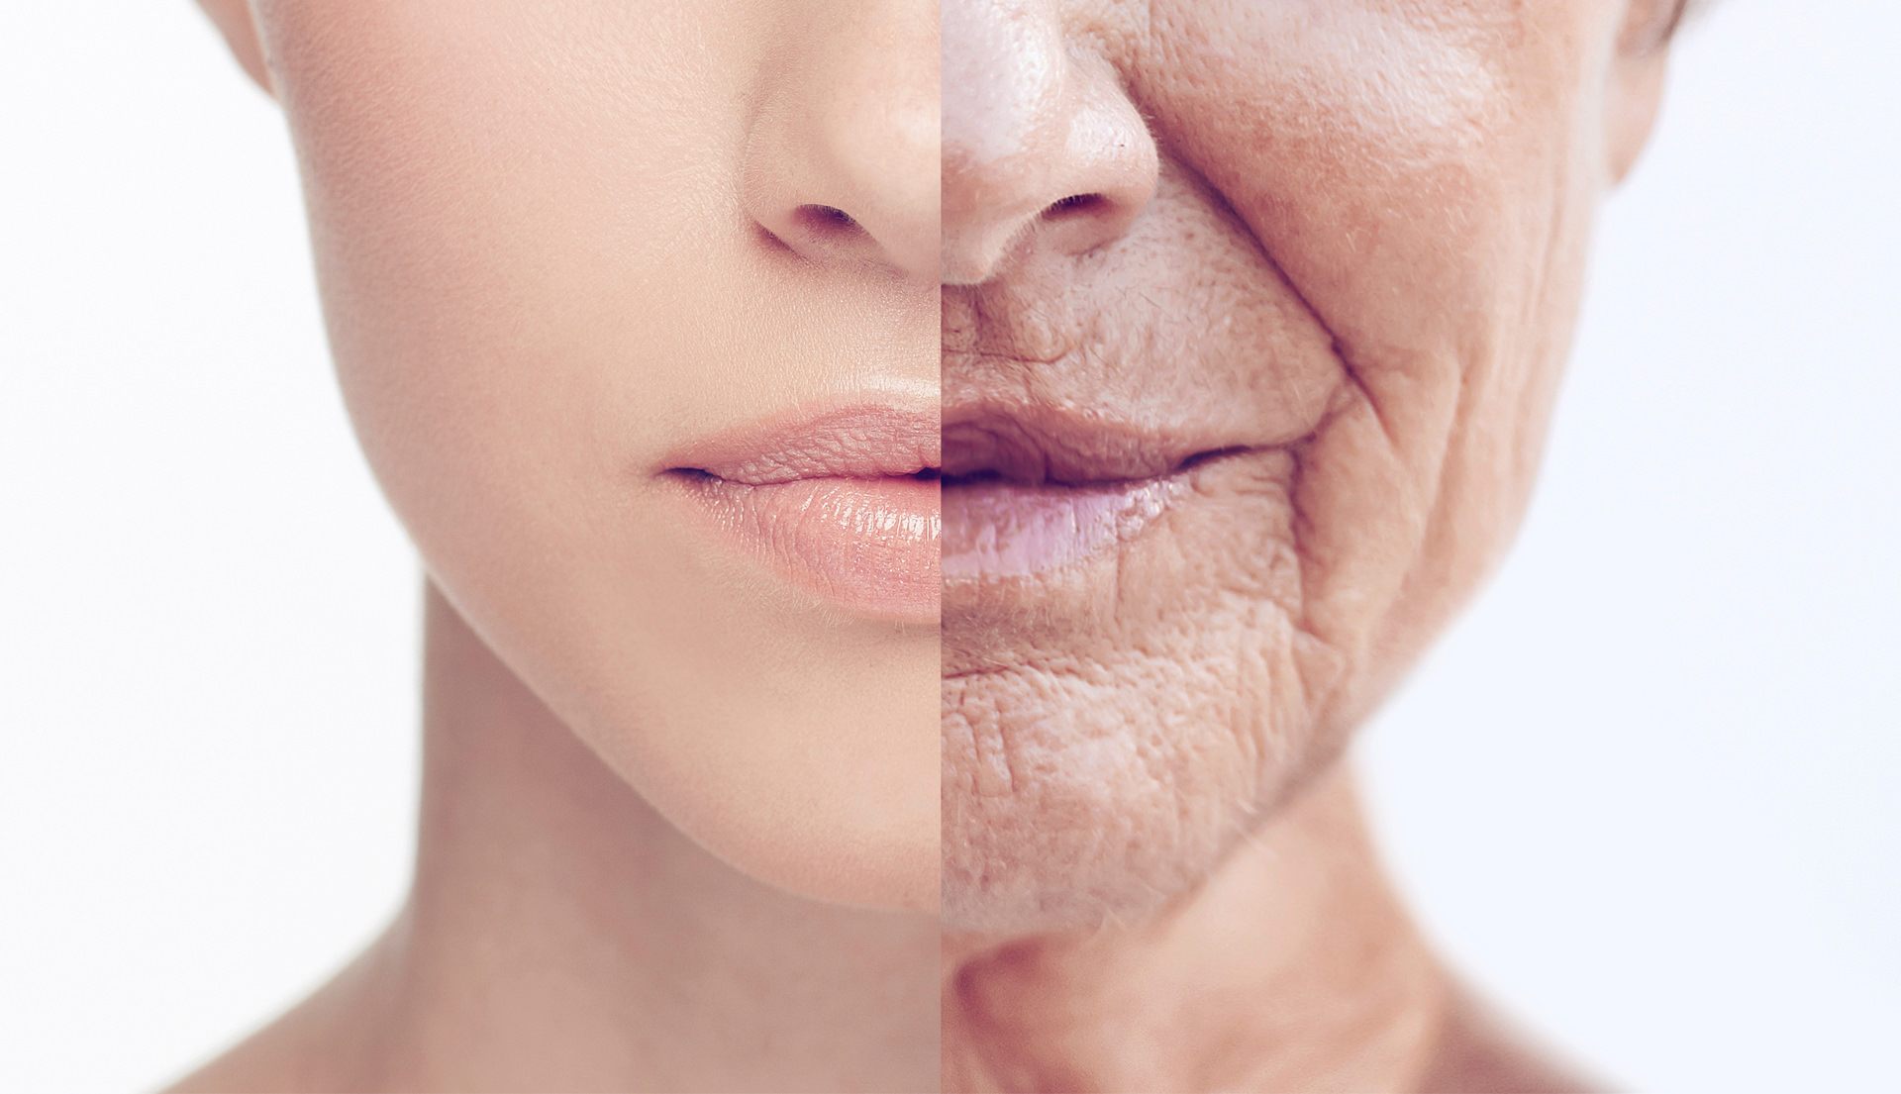

Slide 13
